Slide 1

Overview of Projects
Hannah DeBruin
3/22/2023

Slide 2
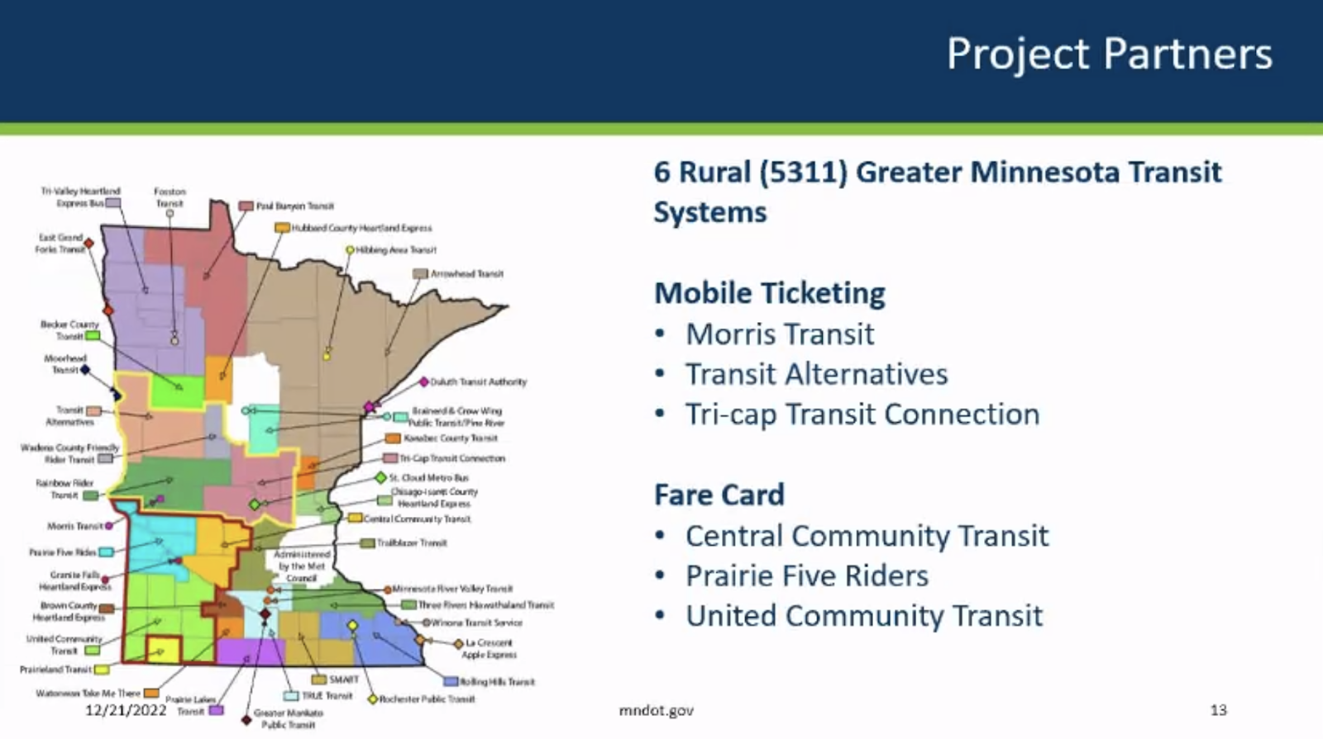









AIM Western MN Contactless Fare Payment Project
How does the introduction of contactless fare payment and trip planning technology affect rural transit user attitudes and ridership after the Covid-19 pandemic?
Task 1: Pre-implementation survey of attitudes and travel behavior
Task 2: Post-implementation survey of attitudes and travel behavior
Task 3: Operational interviews with transit agencies on benefits/drawbacks of new technology
Weekly Meeting (03/22/2023)
Hannah DeBruin

Slide 3








AIM Southern MN Contactless Fare Payment Project
How does the introduction of a Mobility as a Service (MaaS) platform benefit residents through improved mobility options? How does it increase transit ridership? How can its features be optimized for high system efficiency?
Task 1: Pre-implementation analysis of existing shared mobility systems
Both urban and rural, fixed route and demand-responsive transit data were collected with agency assistance
Task 2: Post-implementation analysis of MaaS app trip data
Travel patterns will be compared to pre-implementation travel patterns and an urban and rural control system without MaaS app
Rider time/cost savings, equity impacts, and ridership, fare collection, and operating cost savings documented
Task 3: Final report summarizing results
Weekly Meeting (03/22/2023)
Hannah DeBruin

Slide 4
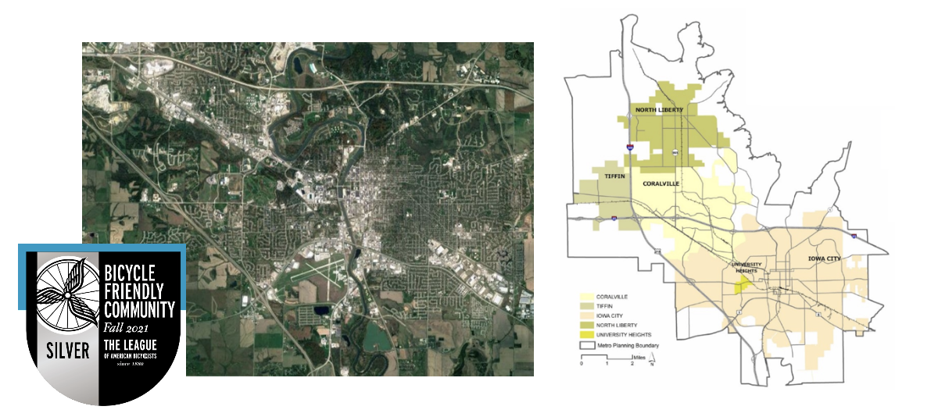


Bikeshare Station Siting Optimization Project
Developing a new tool to optimize bikeshare station locations in small urban areas with a lack of data/planning resources and multiple policy goals
Weekly Meeting (03/22/2023)
Hannah DeBruin

Slide 5
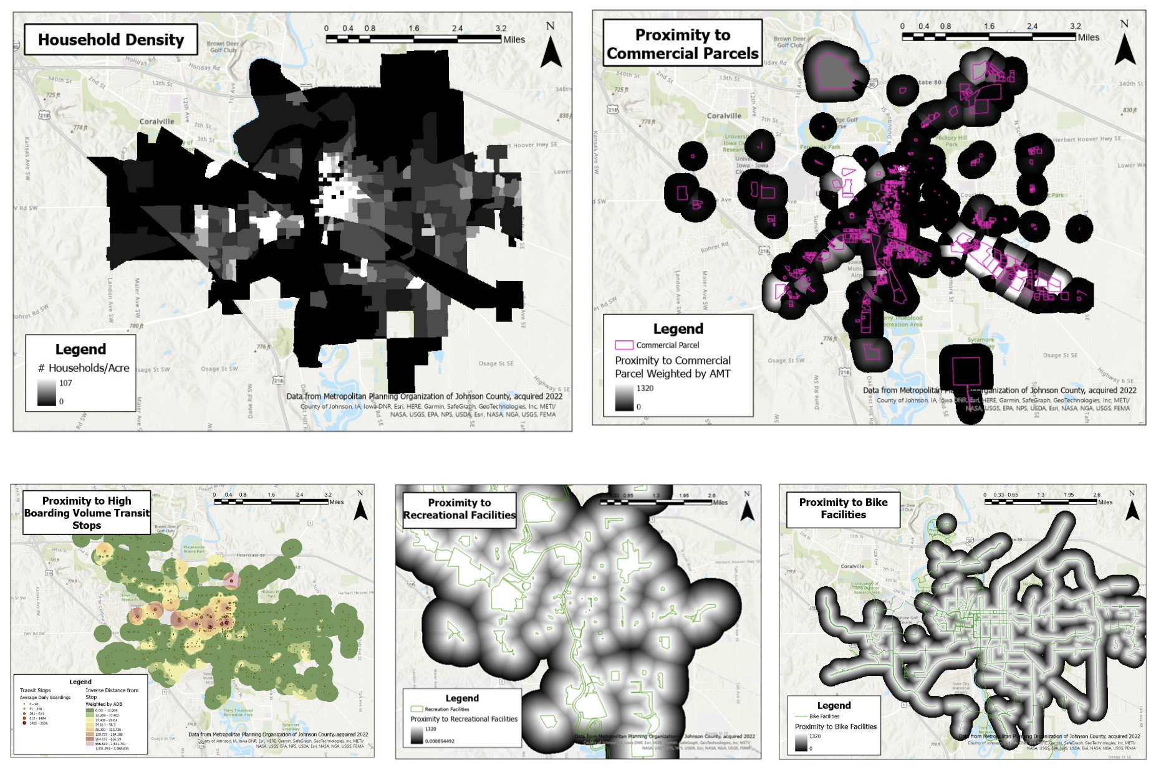
Bikeshare Station Siting Optimization Project
Developing a new tool to optimize bikeshare station locations in small urban areas with a lack of data/planning resources and multiple policy goals
Task 1: Identifying important (and easily available) demand indicators/input criteria
Household density
Proximity to transit stops
Proximity to bike facilities
Proximity to parks/recreation facilites
Proximity to jobs, low-income jobs, retail, restaurants, etc
Student housing density
Proximity to K-12 schools
Proximity to top employment campuses
Located in disadvantaged neighborhoods
Located in neighborhoods without vehicle access
Weekly Meeting (03/22/2023)
Hannah DeBruin

Slide 6
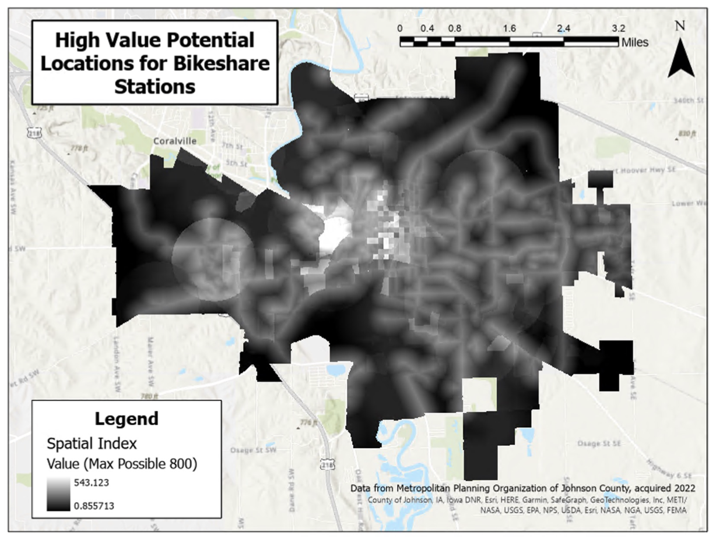
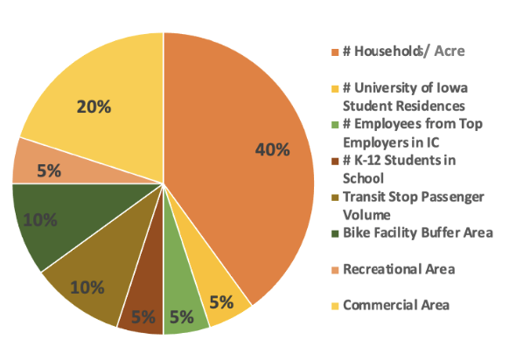
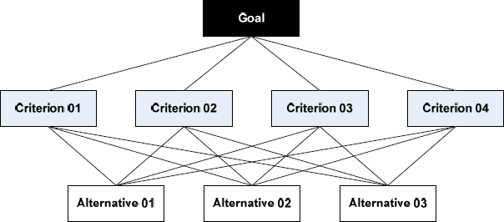
Bikeshare Station Siting Optimization Project
Developing a new tool to optimize bikeshare station locations in small urban areas with a lack of data/planning resources and multiple policy goals
Task 2: Developing propensity analysis “hot spot” map of all possible station locations
Creating a spatial index value by standardizing input criteria and combining into one raster layer
Different inputs weighted by an Analytic Hierarchical Process from a survey of transportation professionals
Weekly Meeting (03/22/2023)
Hannah DeBruin

Slide 7


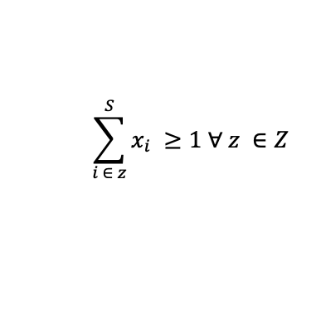
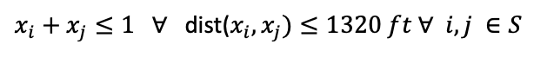
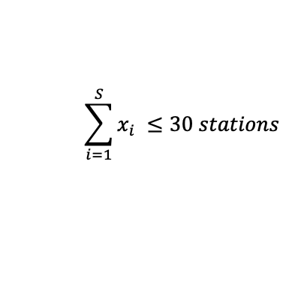
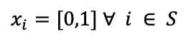
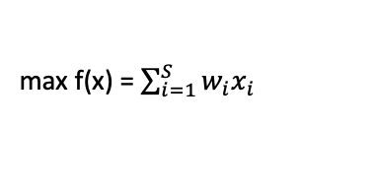
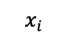
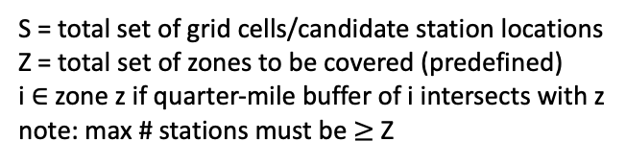
Bikeshare Station Siting Optimization Project
Developing a new tool to optimize bikeshare station locations in small urban areas with a lack of data/planning resources and multiple policy goals
Task 3: Developing optimization model to maximize system value, with a method flexible to multiple transportation goals
max f(x) = $\sum_{i=1}^{S}{w_{i}x_{i}}$
Considering:
Minimum station spacing
Maximum budgeted number of stations
Coverage of all specified neighborhoods
s.t.
$x_{i}=[0,1]$ $∀ i ∈ S$
$$\sum_{i=1}^{S}{x_{i} ≤30 stations}$$
$$\sum_{i ∈ z}^{S}{x_{i} ≥1 ∀ z ∈Z }$$
$x_{i}+x_{j}≤1 ∀$ dist($x_{i},x_{j})≤1320 ft ∀ i,j ∈S$
$$x_{i}$$
=1 if station location selected, 0 if station location not selected
S = total set of grid cells/candidate station locations
Z = total set of zones to be covered (predefined)
i $∈$ zone z if quarter-mile buffer of i intersects with z
note: max # stations must be $≥$ Z
Weekly Meeting (03/22/2023)
Hannah DeBruin

